Slide 1
Activity:
Individual Recommendation Report
ECS 2390
University of Texas at Dallas

Slide 2
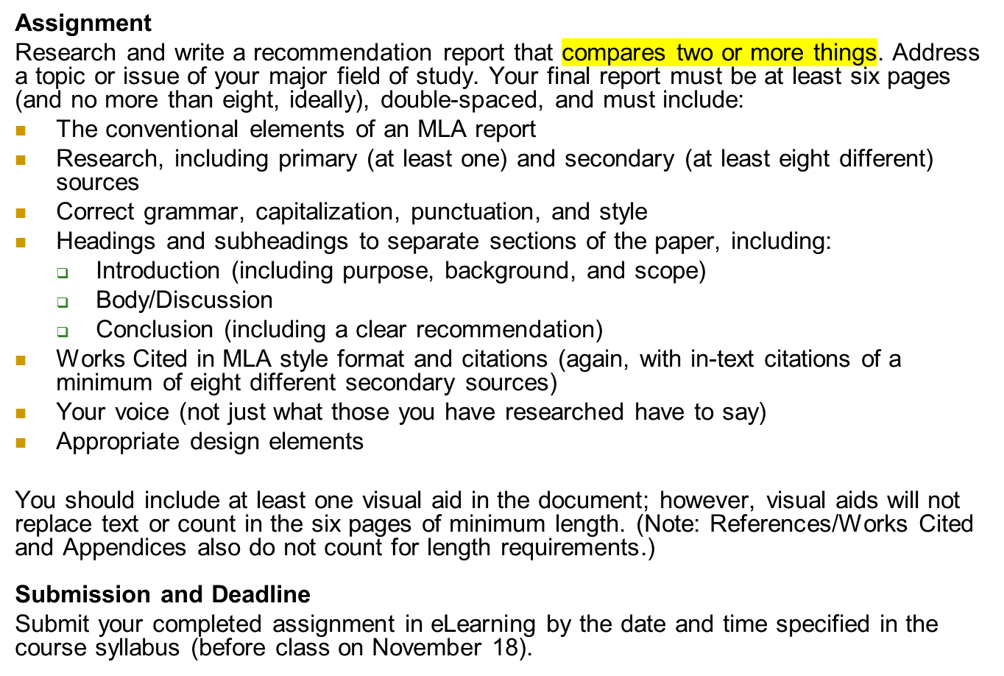
Individual Recommendation Report
ECS 2390
University of Texas at Dallas

